Slide 1
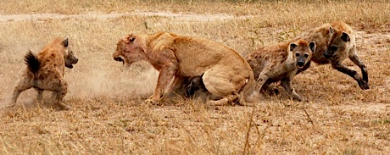
Interspecific Competition

Slide 2
Competition for food etc.
Gause’s Principle (= the competitive exclusion principle).
No two species with the same niche can co-exist for long in the same place.
Either one or both species die out, or they narrow or change their niche.

Slide 3
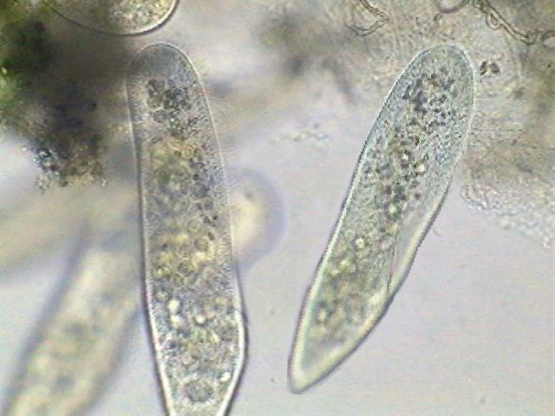
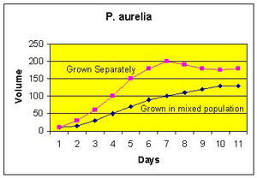
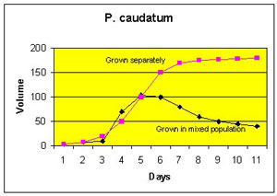
Gause studied 2 species of paramecium.
The graphs below show that when they are grown together, one species dies out

Slide 4
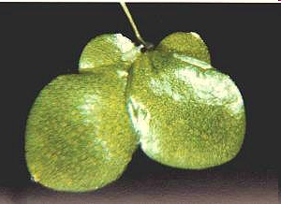
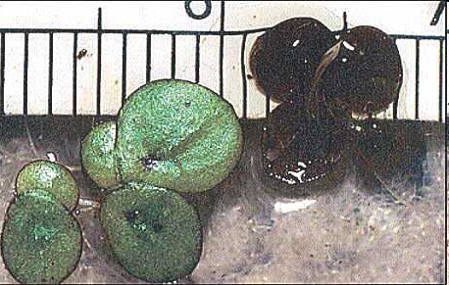
Lemna (duckweed)
In competition between two species of duckweed, Lemna gibba wins while Lemna polyrhiza dies out
L. gibba
L. polyrhiza

Slide 5
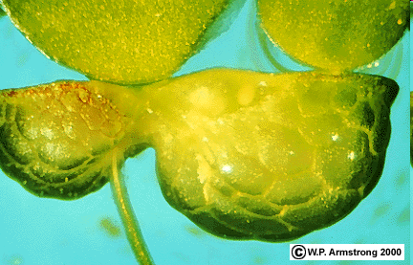
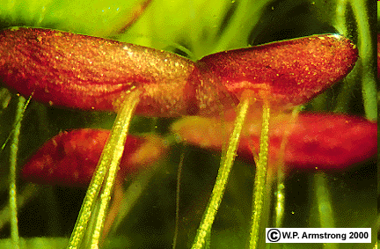
From the side, we see L.gibba has enlarged air pockets which allow it to float above L. polyrhiza which doesn’t.

Slide 6
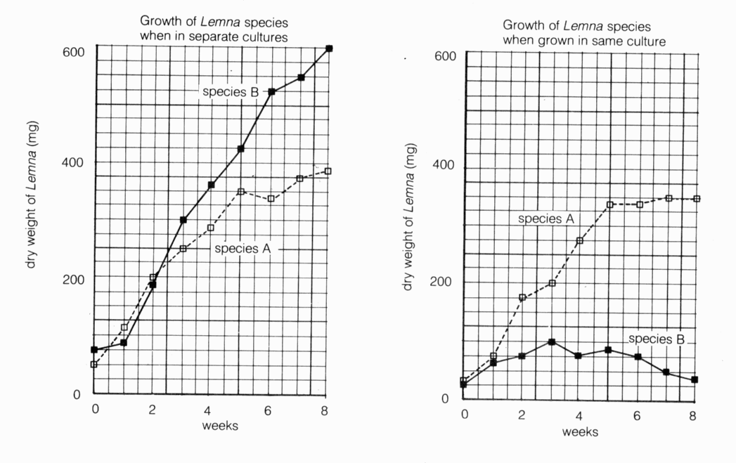

Slide 7
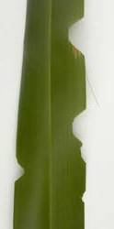
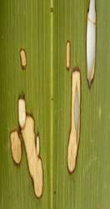
New Zealand example of narrowing of the Niche.
The caterpillars of 2 species of moths both feed on flax leaves.
They reduce competition by eating different parts of the leaves.
  The “notching” caterpillar seldom eats all the way to the mid-vein.
  The “window” caterpillar seldom eats near the edge.

